Slide 1
Electrical Engineering Basics

Slide 2
Capacitors

Slide 3
Transistors

Slide 4
555 Timer Chip

Slide 5
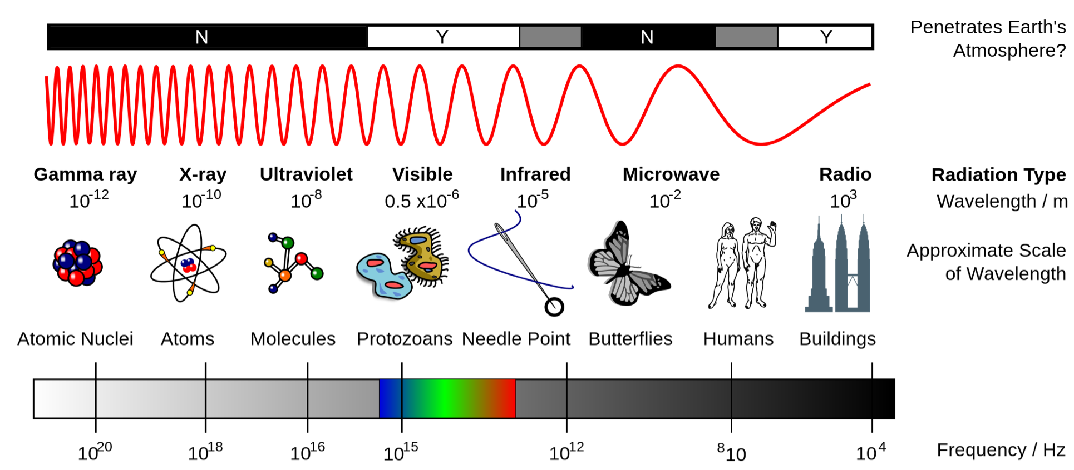
Electromagnetic Spectrum

Slide 6
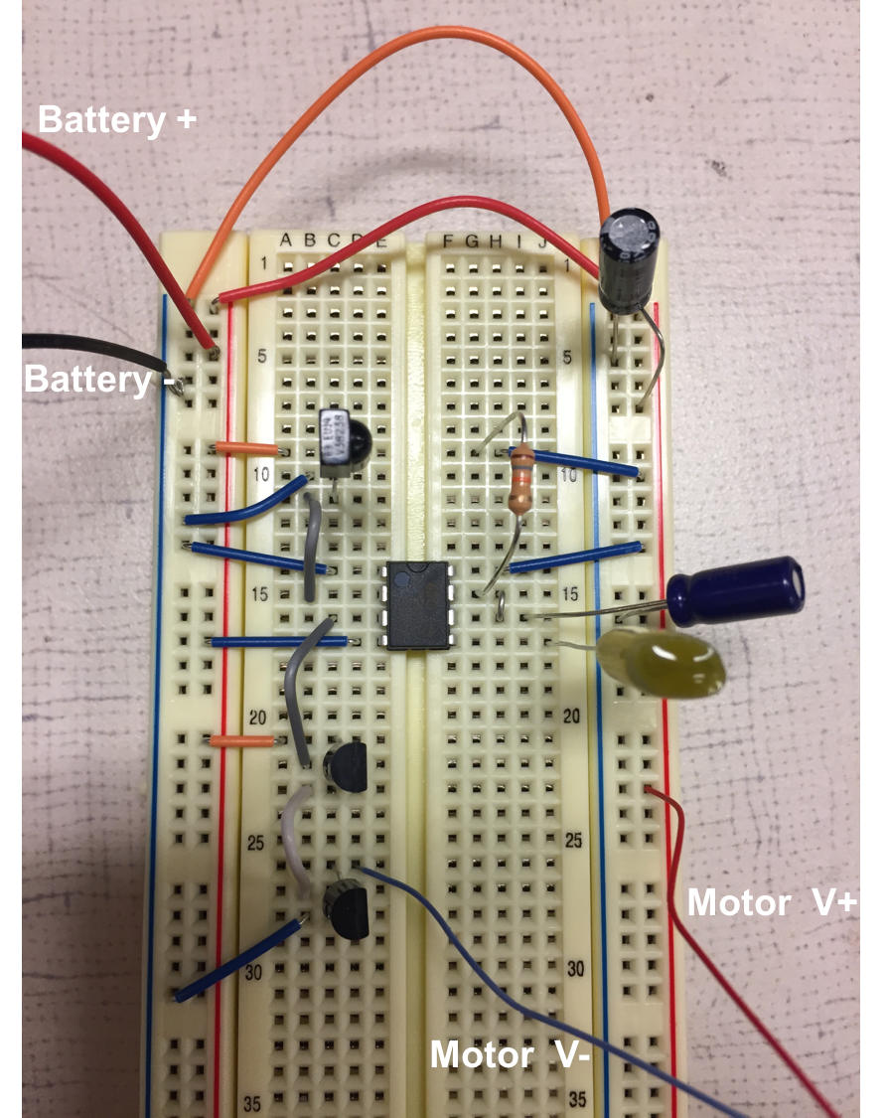

Slide 7
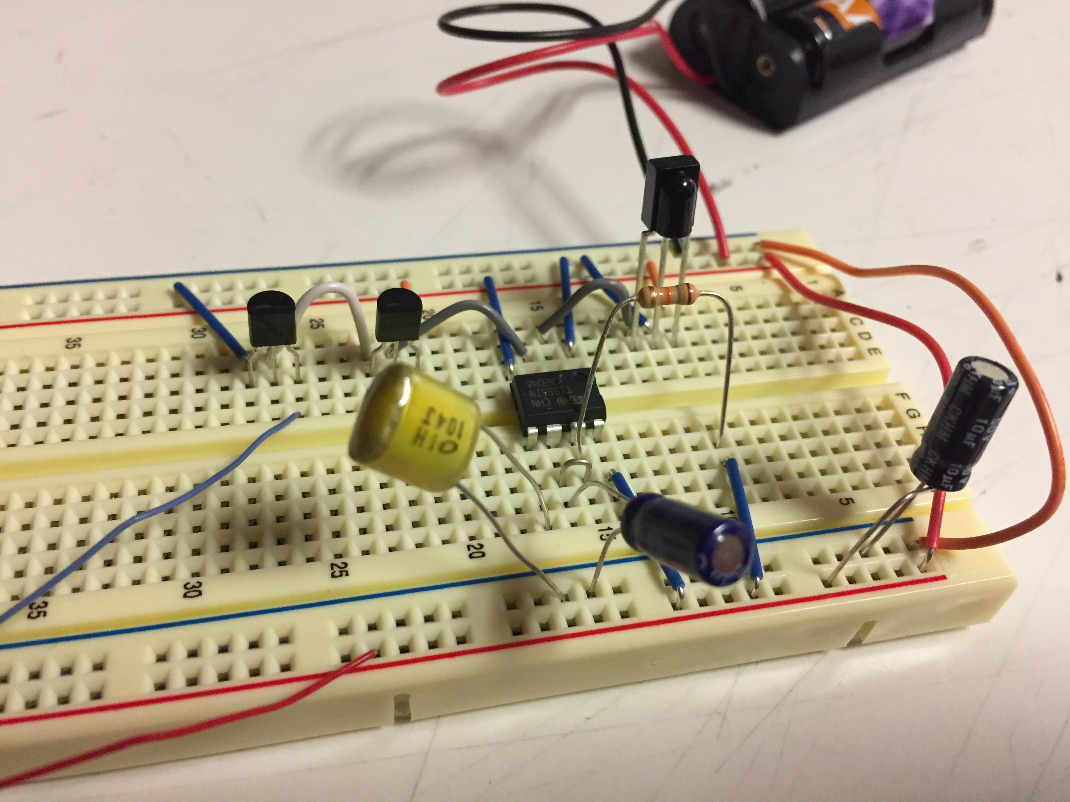

Slide 8
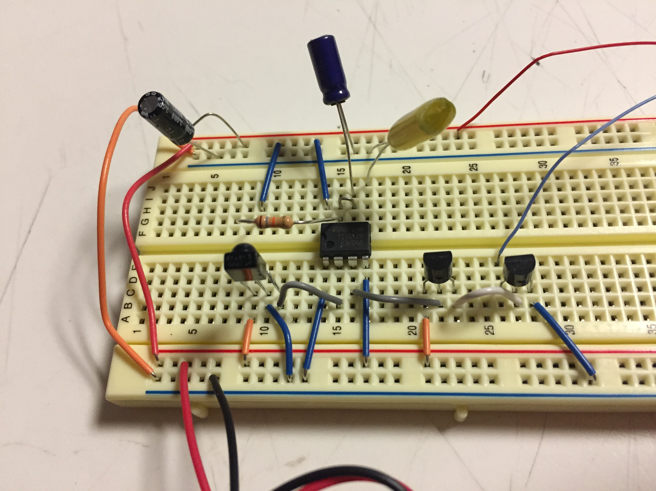

Slide 9
